Slide 1



NOIDA INSTITUTE OF ENGINEERING AND TECHNOLOGY, GREATER NOIDA
Visualization and Generative Models
Unit: 5
Subject Name:
Computer Vision
Faculty Name:
Dr Preeti Gera
Affiliation:
Associate Professor
Department:
CSE
Course Details:
B.Tech 7th Sem

Slide 2

Brief Introduction About Me
Name:- K Prabhanjan kumar
Assistant Professor, IT
NIET , Greter Noida
Qualification
Post Graduated from Pydah Engineering college VIZAG affiliated under JNTU KAKINADA, Andhra Pradesh.
Graduation from Prakasam Engineering college Kandukur affiliated under JNTU KAKINADA, Andhra Pradesh.
Teaching Experience : 9 Years
Technical skills
Big Data & Eco System : Hadoop, Hive, Pig, Sqoop, Flume,
Oozie.
Nosql Databases : Hbase.
Database Languages : Oracle 10g,Mysql.
Operating Systems : Windows Family, Linux (Ubuntu).
Programming Languages : C,Core-java.
IDE : Eclipse.

Slide 3

UNIT-I
UNIT-I: Introduction to Computer Vision:
Introduction to Computer Vision
Computer Vision, Research and Applications, (Self-Driving Cars, Facial Recognition, Augmented & Mixed Reality, Healthcare). Most popular examples Categorization of Images, Object Detection, Observation of Moving Objects, Retrieval of Images Based on Their Contents, Computer Vision Tasks classification, object detection, Instance segmentation. Convolutional Neural Networks, Evolution of CNN Architectures for Image, Recent CNN

Slide 4
UNIT-II
UNIT-II: Architectures
Architectures
Representation of a Three-Dimensional Moving Scene. Convolutional layers, pooling layers, and padding. Transfer learning and pre-trained models Architectures.
Architectures Design: LeNet-5, AlexNet, VGGNet, GoogLeNet, ResNet, Efficient Net, Mobile Net, RNN Introduction.

Slide 5
UNIT-III
UNIT-III: Segmentation
Segmentation
Popular Image Segmentation Architectures, FCN Architecture, Upsampling Methods, Pixel Transformations, Geometric Operations, Spatial Operations in Image Processing, Instance Segmentation, Localisation, Object detection and image segmentation using CNNs, LSTM and GRU’s. Vision Models, Vision Languages, Quality Analysis, Visual Dialogue, Active Contours & Application, Split & Merge, Mean Shift & Mode Finding, Normalized Cuts.

Slide 6
UNIT-IV
UNIT-IV: Object Detection
Object Detection
Object Detection and Sliding Windows, R-CNN, Fast R-CNN, Object Recognition, 3-D vision and Geometry, Digital Watermarking. Object Detection, face recognition instance Recognition, Category Recognition Objects, Scenes, Activities, Object classification.

Slide 7
UNIT-V
UNIT-V: Visualization and Generative Models
Visualization and Generative Models
Object Detection and Sliding Windows, R-CNN, Fast R-CNN, Object Recognition, 3-D vision and Geometry, Digital Watermarking. Object Detection, face recognition instance Recognition, Category Recognition Objects, Scenes, Activities, Object classification.

Slide 8
Syllabus
Unit | Module | Topics Covered
1 | Introduction to Computer Vision: | Computer Vision, Research and Applications, (Self-Driving Cars, Facial Recognition, Augmented & Mixed Reality, Healthcare). Most popular examples Categorization of Images, Object Detection, Observation of Moving Objects, Retrieval of Images Based on Their Contents, Computer Vision Tasks classification, ,object detection, Instance segmentation. Convolutional Neural Networks, Evolution of CNN Architectures for Image, Recent CNN
2 | Architectures | Representation of a Three-Dimensional Moving Scene. Convolutional layers, pooling layers, and padding. Transfer learning and pre-trained models Architectures. Architectures Design : LeNet-5, AlexNet, VGGNet, GoogLeNet, ResNet, Efficient Net, Mobile Net . RNN Introduction, perceptron Backpropagation in CNN,RNN.
3 | Segmentation | Popular Image Segmentation Architectures, FCN Architecture, Upsampling Methods, Pixel Transformations, Geometric Operations, Spatial Operations in Image Processing, Instance Segmentation, Localisation, Object detection and image segmentation using CNNs, LSTM and GRU’s. Vision Models, Vision Languages, Quality Analysis, Visual Dialogue, other attention models, self attention and transformers. Active Contours & Application, Split & Merge, Mean Shift & Mode Finding, Normalized Cuts,
4 | Object Detection | Object Detection and Sliding Windows, R-CNN, Fast R-CNN, Object Recognition, 3-D vision and Geometry, Digital Watermarking. Object Detection, face recognition instance Recognition, Category Recognition Objects, Scenes, Activities, Object classification and detection, Encoder in Code, Decoder in Code, U-Net Code: Encoder, Decoder , Few Shot and zero shot learning, self-supervised learning, Adversarial Robustness, Pruning and model compression, Neural Architecture search, Objects in Scenes. YOLO Fundamentals of Image Formation, Convolution and Filtering.
5 | Visualization and Generative Models | Benefits of Interpretability, Fashion MNIST Class Activation Map code walkthrough, GradCAM,ZFNet.Image compression methods and its requirements,statisticalcompression, spatial compression, contour coding. Deep Generative Models introduction,Generative Adversarial Networks Combination VAE and GAN’s, other VAE and GAN’s deep generative models. GAN Improvements, Deep Generative Models across multiple domains, Deep Generative Models image and video applications.

Slide 9
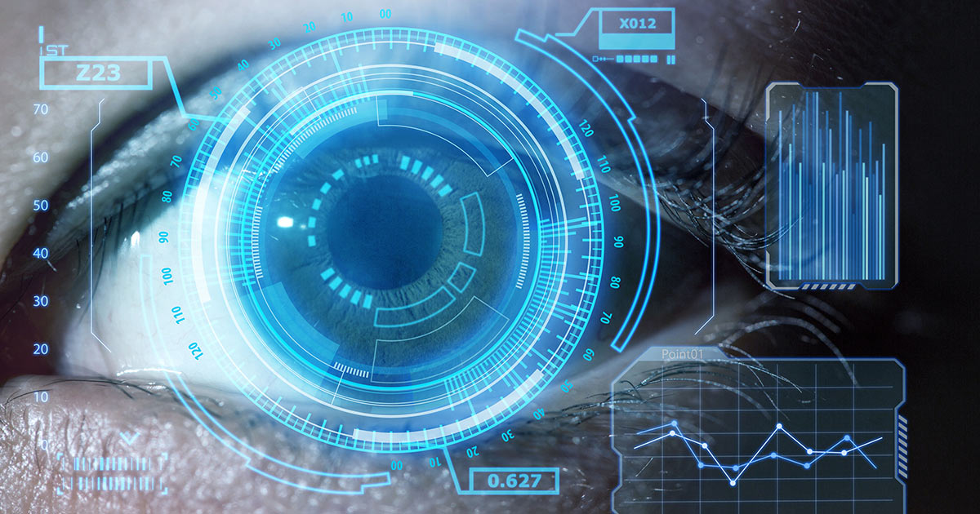
Course Objective
Course Objective: To learn about key features of Computer Vision, design, implement and provide continuous improvement in the accuracy and outcomes of various datasets with more reliable and concise analysis results.

Slide 10
Course Outcome
Course outcome: After completion of this course students will be able to
 | Description | Bloom’s Taxonomy
CO1 | Analyse knowledge of deep architectures used for solving various Vision and Pattern Association tasks. | K4
CO2 | Develop appropriate learning rules for each of the architectures of perceptron and learn about different factors of back propagation. | K2
CO3 | Deploy training algorithm for pattern association with the help of memory network. | K5
CO4 | Design and deploy the models of deep learning with the help of use cases. | K5
CO5 | Understand, Analyse different theories of deep learning using neural networks. | K3

Slide 11
Program Outcome
At the end of the semester, the student will be able:
POs | Engineering Graduates will be able to
PO1 | Engineering Knowledge
PO2 | Problem Analysis
PO3 | Design & Development of solutions
PO4 | Conduct Investigation of complex problems
PO5 | Modern Tool Usage
PO6 | The Engineer and Society
PO7 | Environment and sustainability
PO8 | Ethics
PO9 | Individual & Team work
PO10 | Communication
PO11 | Project management and Finance
PO12 | Life Long Learning

Slide 12
CO-PO and PSO Mapping
Computer vision
CO.K | PO1 | PO2 | PO3 | PO4 | PO5 | PO6 | PO7 | PO8 | PO9 | PO10 | PO11 | PO12
Subject code | 3 |  | 2 |  | 1
Subject code | 2 |  | 1
Subject code |  | 2 |  |  |  | 3
Subject code | 3 | 3 |  | 2
Subject code | 3 |  | 2 |  | 1 |  | 1
avg

Slide 13
Program Educational Objectives(PEOs)
PEO1: To have an excellent scientific and engineering breadth so as to
comprehend, analyze, design and provide sustainable solutions for
real-life problems using state-of-the-art technologies.
PEO2:To have a successful career in industries, to pursue higher studies or
to support enterpreneurial endeavors and to face global challenges.
PEO3:To have an effective communication skills, professional attitude,
ethical values and a desire to learn specific knowledge in emerging
trends, technologies for research, innovation and product
development and contribution to society.
PEO4: To have life-long learning for up-skilling and re-skilling for
successful professional career as engineer, scientist, enterpreneur
and bureaucrat for betterment of society

Slide 14
End Semester Question Paper Template
B TECH
(SEM-VII) THEORY EXAMINATION 20__-20__
COMPUTER VISION
Time: 3 Hours Total Marks: 100
Note: 1. Attempt all Sections. If require any missing data; then choose suitably.
SECTION A
Attempt all questions in brief. 2 x 10 = 20
Q.No. | Question | Marks | CO
1 |  | 2
2 |  | 2
. |  | .
10 |  | 2

Slide 15
End Semester Question Paper Templates
SECTION B
2. Attempt any three of the following: 3 x 10 = 30
SECTION C
3. Attempt any one part of the following: 1 x 10 = 10
Q.No. | Question | Marks | CO
1 |  | 10
2 |  | 10
. |  | .
5 |  | 10
Q.No. | Question | Marks | CO
1 |  | 10
2 |  | 10

Slide 16
End Semester Question Paper Templates
4. Attempt any one part of the following: 1 x 10 = 10
5. Attempt any one part of the following: 1 x 10 = 10
6. Attempt any one part of the following: 1 x 10 = 10
Q.No. | Question | Marks | CO
1 |  | 10
2 |  | 10
Q.No. | Question | Marks | CO
1 |  | 10
2 |  | 10
Q.No. | Question | Marks | CO
1 |  | 10
2 |  | 10

Slide 17
Unit Content
CONTENT
Object Detection
Object Detection and Sliding Windows
R-CNN
Fast R-CNN
Object Recognition
3-D vision and Geometry
, Digital Watermarking
Object Detection
face recognition
instance Recognition
Category Recognition Objects, Scenes
Activities, Object classification

Slide 18
CO-PO and PSO Mapping
 | PSO1 | PSO2 | PSO3
Subject code |  | 1 | 2
Subject code |  |  | 2
Subject code | 1
Subject code | 1 | 2 | 3
Subject code | 1 | 1 | 2
avg
*3= High *2= Medium *1=Low

Slide 19
PREREQUISITE
Students should have the knowledge of computer organization
Students should know the artificial intelligence basic concepts.
Students should be able to create, design and manipulate the images and idea about pixels

Slide 20
PREREQUISITE
Prerequisites
No prior experience with computer vision is assumed, although previous knowledge of visual computing or signal processing will be helpful (e.g., CSCI 1230). The following skills are necessary for this class:
Math: Linear algebra, vector calculus, and probability. Linear algebra is the most important and is required.
Data structures: You will write code that represents images as matrices, high-dimensional features, and geometric constructions.
Programming and toolchains: A good working knowledge. Intro CS is required, and an intermediate systems course is strongly encouraged.

Slide 21
Introduction to GANs
Generative: You can think of the term generative as producing something. This can be taking some input images and producing an output with a twist. For example, you can transform a horse into a zebra with some degree of accuracy. The result depends on the input and how well-trained the layers are in the generative model for this use case.
Adversarial: You can think of the term adversarial as pitting one thing against another thing. In the context of GANs, this means pitting the generative result (fake images) against the real images present in the data set. The specific mechanism is called a discriminator, which is implementing a model that tries to discriminate between the real and fake images.

Slide 22
Introduction to GANs
"The generative model can be thought of as analogous to a team of counterfeiters, trying to produce fake currency and use it without detection, while the discriminative model is analogous to the police, trying to detect the counterfeit currency. Competition in this game drives both teams to improve their methods until the counterfeits are indistinguishable from the genuine articles."
Goodfellow demonstrated how you could use the modern-day computing power to generate fake examples that look like real images of numbers, people, animals, and anything you might imagine. As long as you can curate the data, these types of models can generate novel examples. In the following image. the yellow columns are examples of generated images from Goodfellow's paper

Slide 23
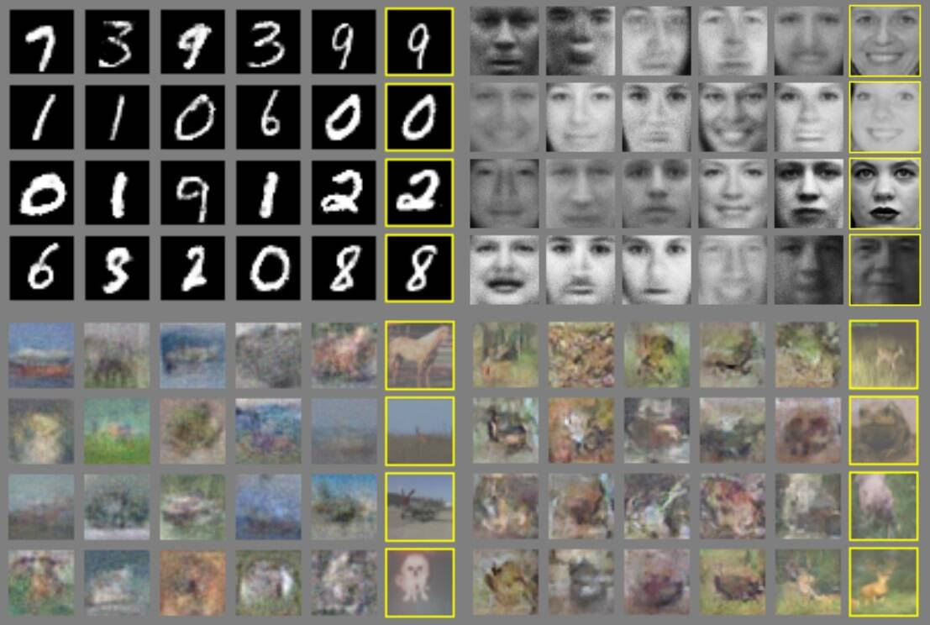
Introduction to GANs

Slide 24
Components GANs
Components in a GAN model
As previously explained, GANs consist of a generative and an adversarial network. Although there are many different GAN models, I focus on the core components of the most common one deep convolutional generative adversarial networks (DCGAN), which was introduced in 2015 by Alec Radford et al. I also discuss use cases with newer models that have tweaked the components of the model to create something unique.

Slide 25
Components GANs
Replacing any pooling layers with strided convolutions (discriminator) and fractional-strided convolutions (generator)
Using batch norm (BN) in both the generator and the discriminator
Removing fully connected hidden layers for deeper architectures
Using ReLU activation in the generator for all layers except for the output, which uses Tanh
Using LeakyReLU activation in the discriminator for all layers

Slide 26
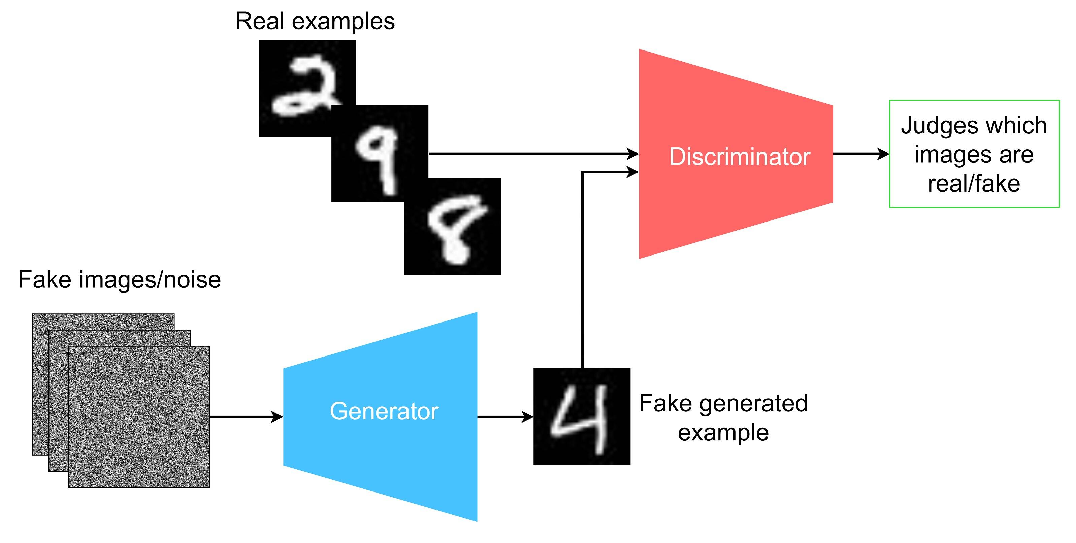
Introduction to GANs

Slide 27
Generative Adversarial Networks (GANs)
Generator
For the generator, you can input random images (also known as noise). These random images can be anything, but might also be generated or augmented data. Through the generator, you generate a sample that hopefully ends up looking like it is part of the real data set if you train the generator and discriminator to both be good enough. The generator's output is sometimes referred to as the latent space or a latent vector.
To optimize the generator, you first must pass the output of the generator through the discriminator. Subsequently, you can backpropagate and calculate the errors of both the generator and the discriminator (to be covered in the next section).
There are only a few components in the actual generator itself, all of which are typical components in convolutional neural networks. The type of convolution used in the generator is called a deconvolution, which is also known as a transposed convolution. Other components include the typical batch normalization and activation functions.
The way that the deconvolution is constructed and the way the parameters (stride, padding, and kernel size) are set for the individual deconvolutions make it possible to upscale and generate a new image that is supposed to resemble the input.

Slide 28
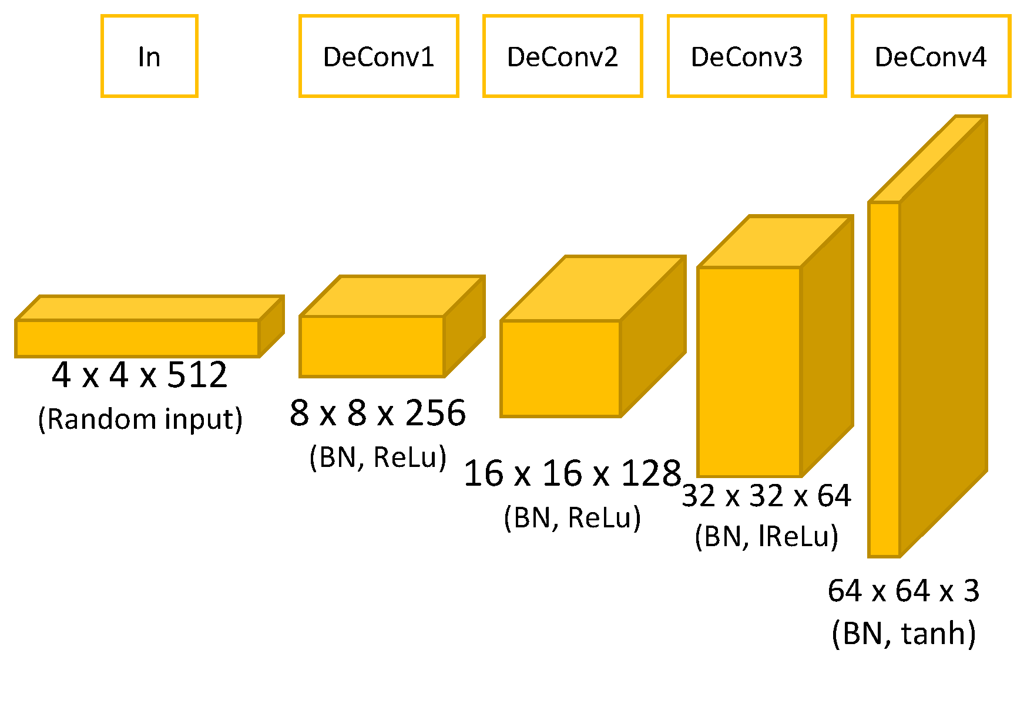
Generative Adversarial Networks (GANs)

Slide 29
Generative Adversarial Networks (GANs)
Discriminator
For the discriminator, you input the real images from the actual data set that you curated. In this instance, I chose the MNIST data set, which is a large collection of handwritten digits. Additionally, you also input the output of the generator into the discriminator.
The convolutional layer of the discriminator is the normal convolution that we're used to. The convolutions are parameterized to downscale the input that is suitable for classification. For the discriminator, you run both inputs through the model to receive an output that is judged by adding a fully connected layer and a sigmoid activation function at the end.

Slide 30
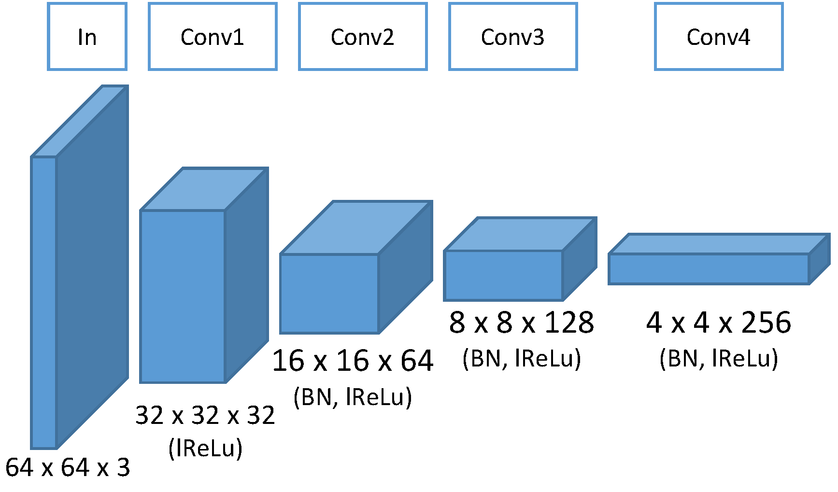
Generative Adversarial Networks (GANs)

Slide 31
Generative Adversarial Networks (GANs)
Optimization
After the data is passed through both the generator and the discriminator model, the optimization with backpropagation begins like in all other networks.
Optimization is a tough subject in GANs because both models need to keep improving at a level pace for both models to become great. You want the generator to try to outsmart the discriminator by generating better fakes, but you also want the generator to make a correct classification of both the real and fake input so that the generator can keep getting better. Eventually, you reach a point of equilibrium when the generator outputs images that look real enough to be part of the original data set that you use to train the discriminator.
The equilibrium point is exactly when the discriminator is leaning 50% to both sides, meaning that both images could either be real or fake. This means that the generator model tries to minimize the probability that the discriminator will predict the generator's output as fake. On the other side, the discriminator tries to maximize the probability that it will correctly classify both real and fake images.

Slide 32
Generative Adversarial Networks (GANs)
Use case review
You might ask, why are GANs so interesting? It's because they have endless possibilities and are only limited by what you can think of. GANs have many use cases, some of which I describe in the following sections.
Data manipulation
Today, you can easily manipulate images with all of the latest research. You can transfer the style from one image onto the wanted image, thus creating a new and manipulated image that looks real.
There are too many applications to mention, so I chose one simple example. In the following image, you see how a GAN application can manipulate any facial feature of an image of Ryan Gosling.

Slide 33
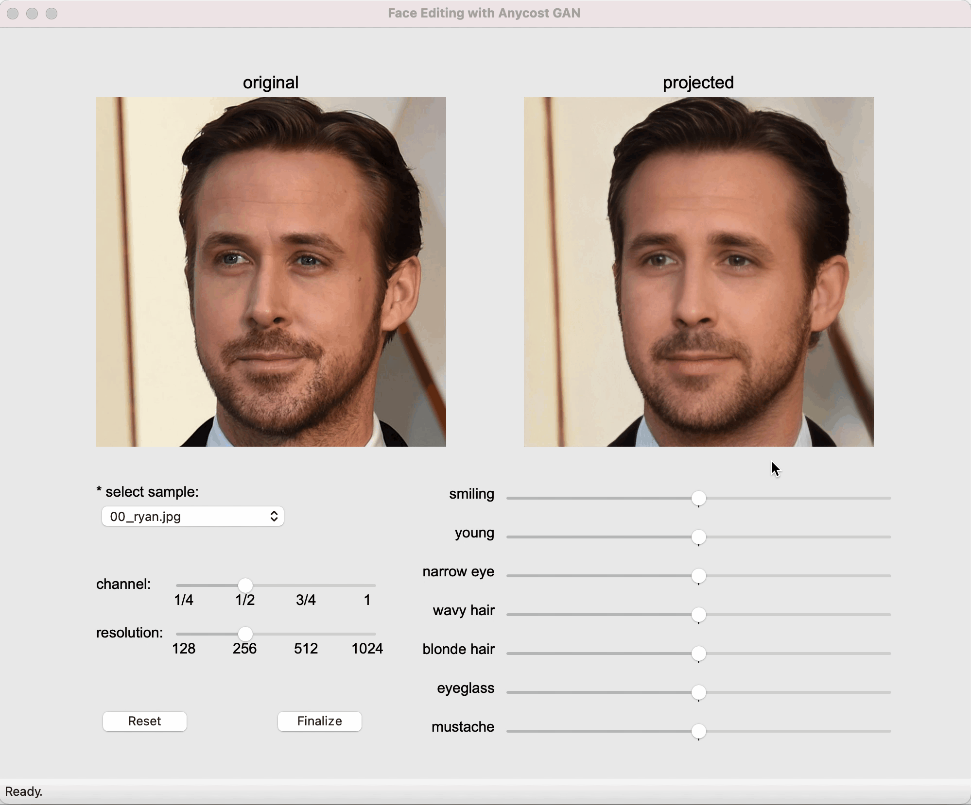

Slide 34
Generative Adversarial Networks (GANs)
Security
Every day, the threat landscape is increasing as attackers develop sophisticated software and use social engineering to target organizations and individuals to steal valuable and sensitive information.
With modern GANs, you can mask employee photos, medical images, or street-view images, rendering them useless to any attacker. If you want to use the photos at any time, you just use your GAN again to map the masked image back to the original one.
Before hiding the data, the sender sends an extractor and a restorer to the receiver.
Both sides learn a mapping from secret data to noise. Corresponding to the traditional remote data handler methods, the image that is generated can be regarded as the cover image and marked image. Then, the sender sends the marked image to the receiver. At the receiver side, the recovered image can be obtained, and the embedded data can be extracted.

Slide 35
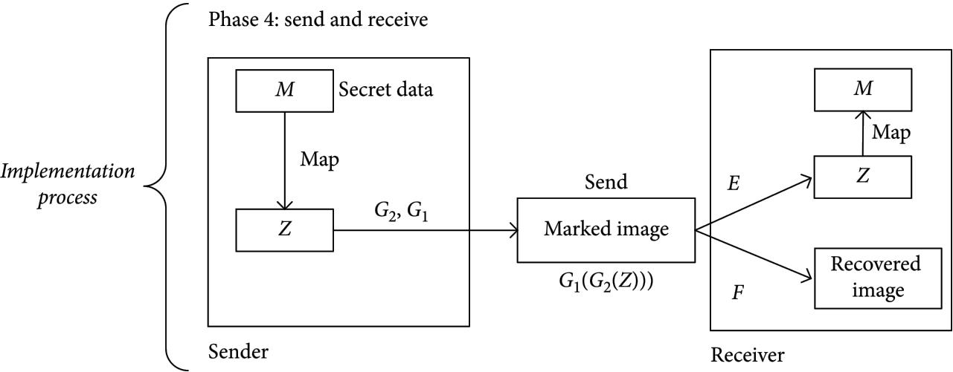
Generative Adversarial Networks (GANs)

Slide 36
Generative Adversarial Networks (GANs)
Data generation
Deep learning algorithms always need more data. In fact, it's so crucial that there are ways to generate extra data. As with all AI models, you use more data to improve the model that you want to train because that yields better performance in the end. In some cases, there is even a limited amount of data that can restrict you from training a good model.
The data generation use cases are endless. You can generate all different types of images or text. Earlier in my explanation of the generator and discriminator, you might also start to understand how you can use a properly trained generator to generate new samples of data for use in a real data set to train an entirely different model.
One of the latest examples includes OpenAI's DALL-E 2, a text-to-image generation model.

Slide 37
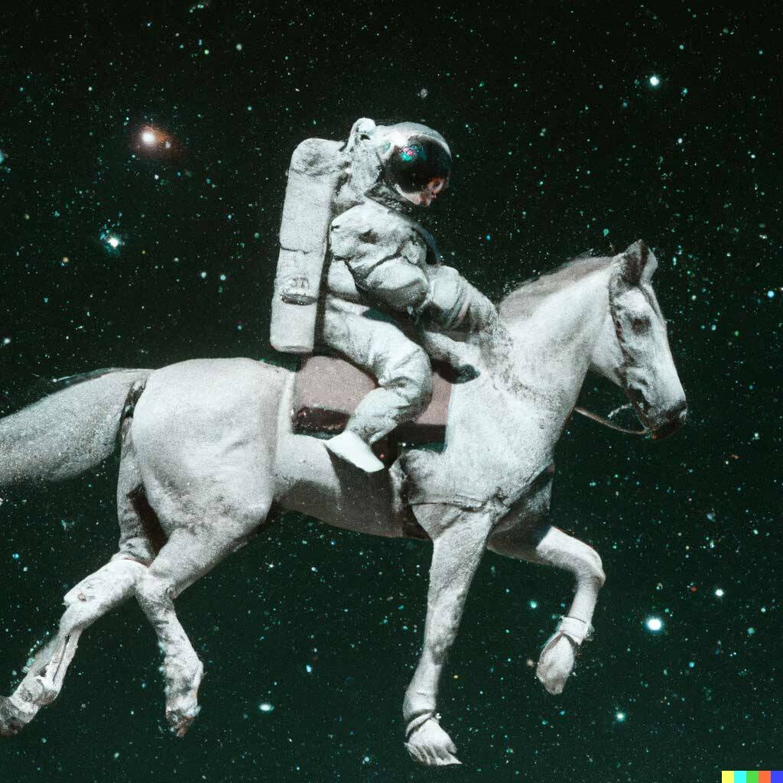
Generative Adversarial Networks (GANs)

Slide 38
Generative Adversarial Networks (GANs)
Privacy
Data confidentiality is a huge subject when it comes to privacy, and there are many cases where you want to protect your data. One example is military applications, but consumers are also increasingly interested in their
communication being protected by technology. However, cryptography schemes all have their limitations. As an example of ways to fix this, Google implemented their own GAN for cryptography.
The Google GAN paper explains that "A classic scenario in security involves three parties: Alice, Bob, and Eve. Typically, Alice and Bob wish to communicate securely, and Eve wishes to eavesdrop on their communications. Thus, the desired security property is secrecy (not integrity), and the adversary is a “passive attacker” that can intercept communications.

Slide 39
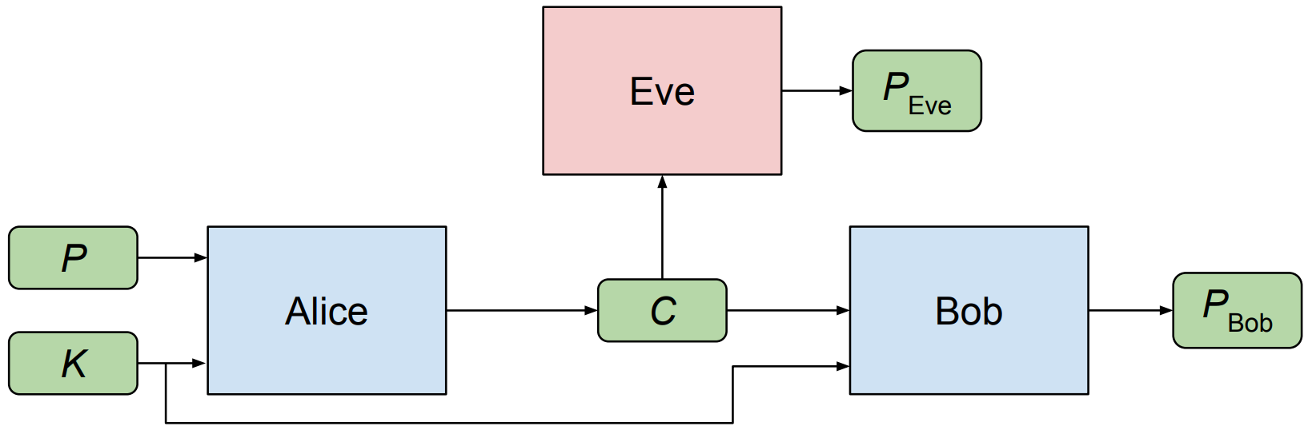
Generative Adversarial Networks (GANs)

Slide 40
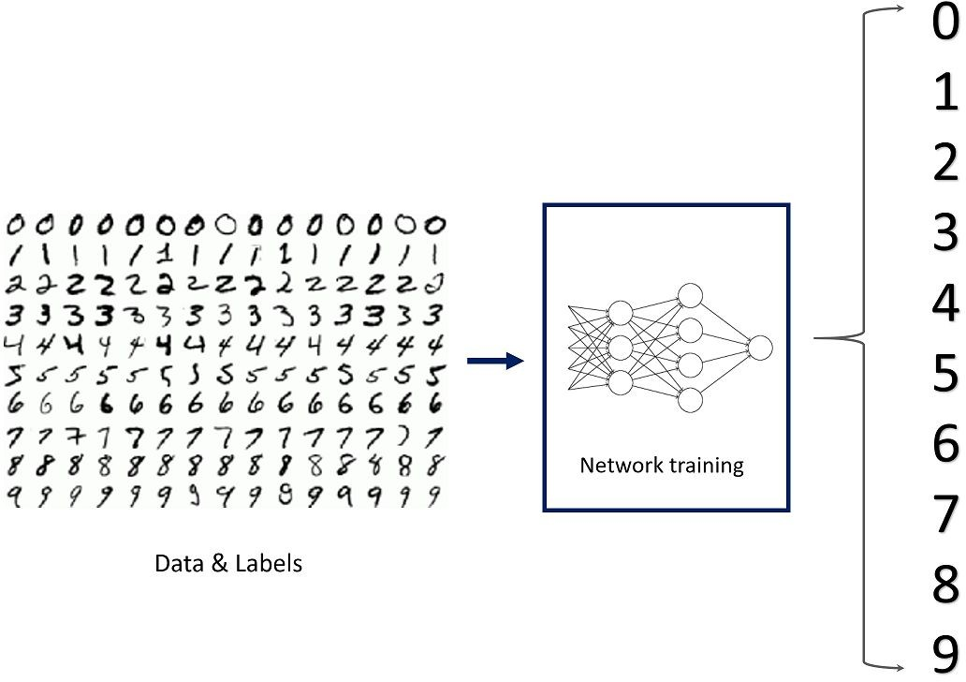
Supervised Learning
Supervised Learning
Supervised Learning
Data: (x, y) where x is data, y is label
Goal: Learn a function to map x→ y
Examples: Classification, Object Detection,
Semantic segmentation, Image captioning
Slide #40

Slide 41
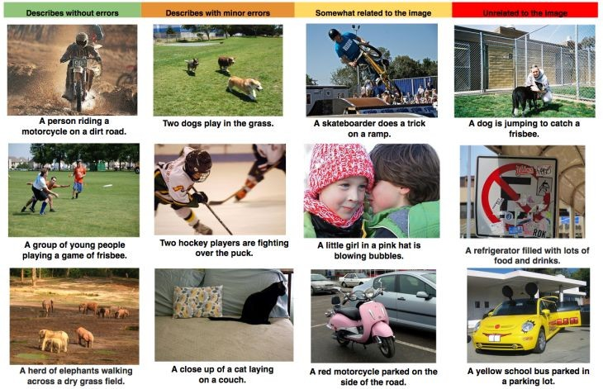
Supervised Learning
Supervised Learning
Supervised Learning
Data: (x, y) where x is data, y is label
Goal: Learn a function to map x→ y
Examples: Classification, Object Detection,
Semantic segmentation, Image captioning
Slide #41

Slide 42
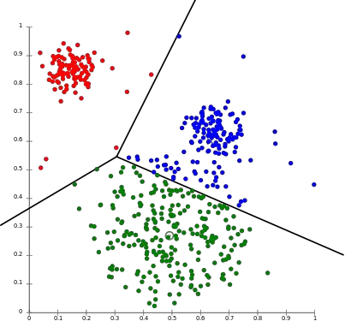
Unsupervised Learning
UnSupervised Learning
Unspervised Learning
Data: x, NO labels!!
Goal: Learn some underlying hidden structure of the data
Examples: Clustering, Dimensionality reduction,
Feature learning, Density estimation
K-means clustering
Slide #42

Slide 43
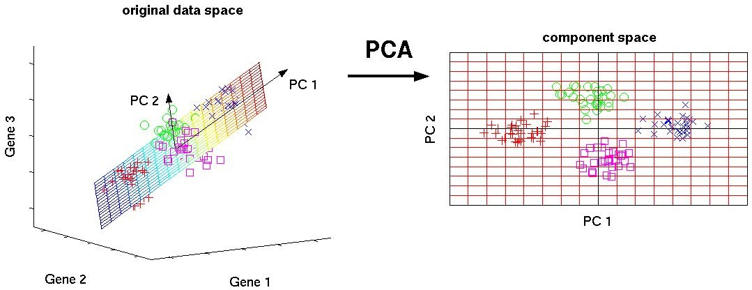
Unsupervised Learning
UnSupervised Learning
Unspervised Learning
Data: x, NO labels!!
Goal:Learn some underlying hidden structure of
the data
Principal Component Analysis
Examples: Clustering, Dimensionality reduction,
Feature learning, Density estimation
Slide #43

Slide 44
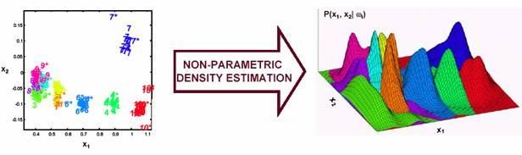
Unsupervised Learning
UnSupervised Learning
Unspervised Learning
Data: x, NO labels!!
Goal:Learn some underlying hidden structure of the data
Density estimation
Examples: Clustering, Dimensionality reduction,
Feature learning, Density estimation
Slide #44

Slide 45
Supervised vs Unsupervised Learning
Supervised vs Unsupervised Learning
Supervised Learning
Data: (x, y)
x is data, y is label
Goal: Learn a function to map x -> y
Unsupervised Learning
Training data is cheap
Data: x
Just data, no labels!
Goal: Learn some underlying hidden structure
Solve unsupervised learning =>
understand structure of visual world
Examples: Clustering, dimensionality reduction, feature learning, density estimation, etc.
of the data
Examples: Classification, Object detection , Semantic segmentation, Image captioning, etc.
Slide #45

Slide 46
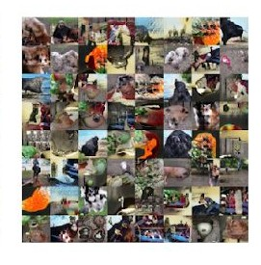
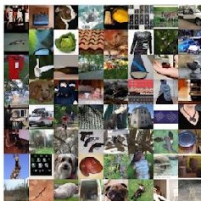
Generative Models
Generative Models
Given training data, generate new samples from same distribution
Training data ~ p_{data}(x) Generated samples ~ p_{model}(x)
Want to: learn p_{model}(x) similar to p_{data}(x)
Addresses density estimation which is a core problem in unsupervised learning
Slide #46

Slide 47
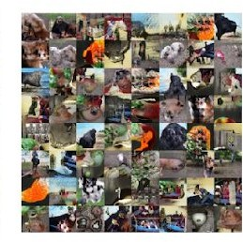
Generative Models
Generative Models
Given training data, generate new samples from same distribution
Training data ~ p_{data}(x) Generated samples ~ p_{model}(x)
Want to: learn p_{model}(x) similar to p_{data}(x)
Addresses density estimation which is a core problem in unsupervised learning
Explicit density estimation: explicitly define and solve for p_{model}(x)
Implicit density estimation: learn model that can sample from p_{model}(x) without explicitly defining it
Slide #47

Slide 48

Why Generative Model?
Generative Models
Slide #48

Slide 49
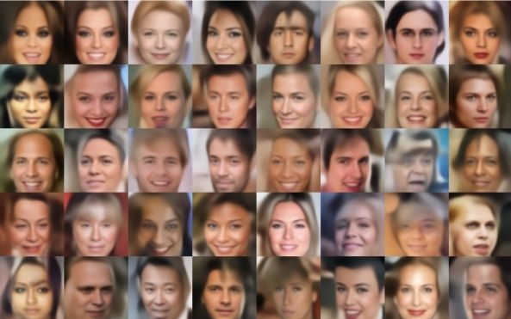
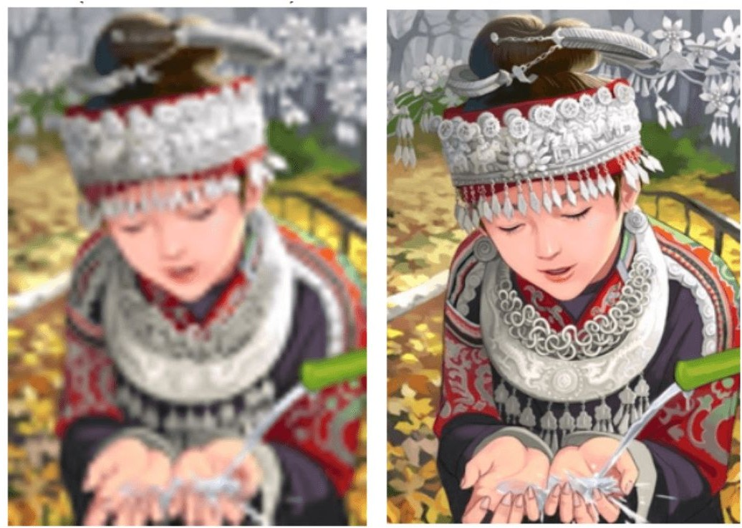
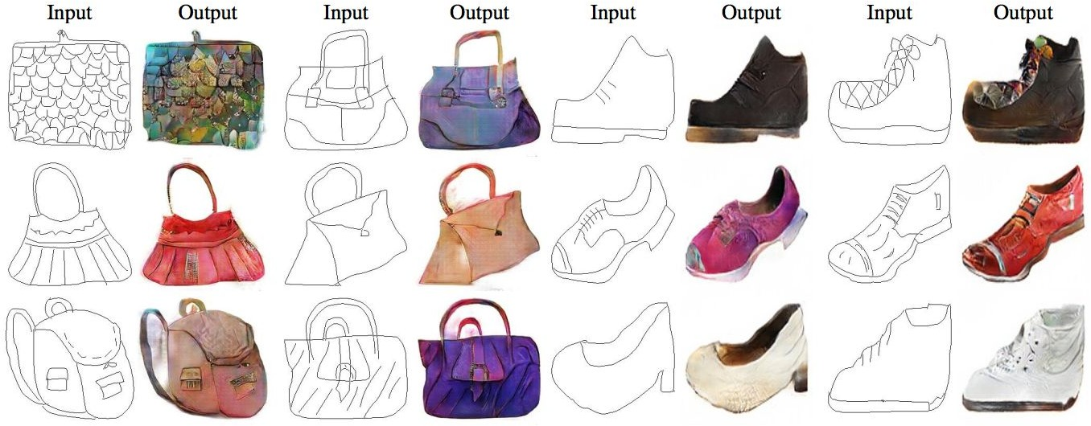
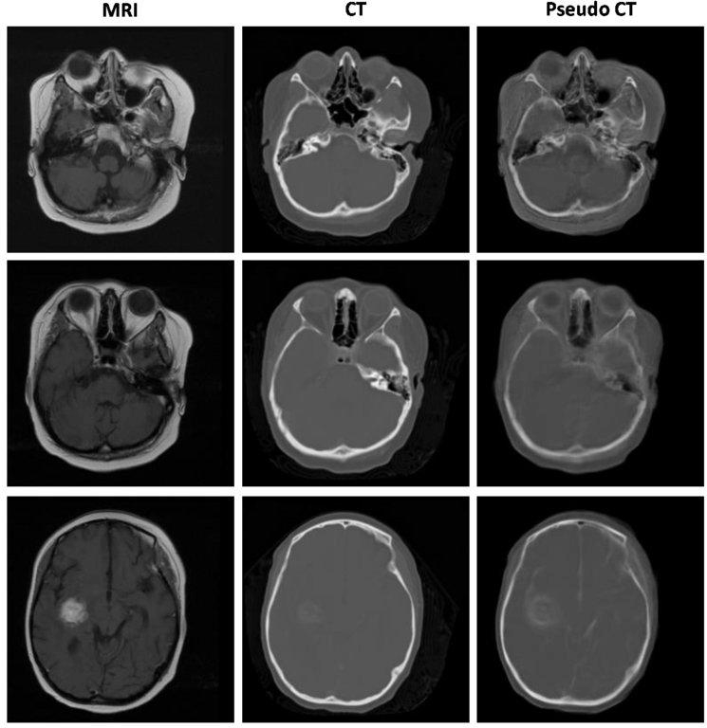
Why Generative Model?
Generative Models
Increasing dataset, realistic samples for artwork, super-resolution, colorization, etc.
Generative models of time-series data can be used for simulation and planning.
Slide #49

Slide 50


Taxonomy of Generative Models
Taxonomy of Generative Models
Generative Model
Explicit Density
Implicit Density
Tractable Density
Approximate Density
Direct
Markov chain
Change of variables models Fully Visible Belief Nets
PixelRNN
Variational
Markov chain
GAN
GSN
PixelCNN
Variational Autoencoder
Boltzmann Machine
Figure copyright and adapted from Ian Goodfellow, Tutorial on Generative Adversarial Networks,
Deep Learning for Computer Vision
2017.
Generative Models
Slide #14

Slide 51

Fully visible belief network
Fully visible belief network
Explicit density model
Use chain rule to decompose likelihood of an image x into product of 1-d distributions:
Likelihood of
image x
Probability of i’th pixel value
given all previous pixels
Then maximize likelihood of training data

Slide 52
Fully visible belief network
Fully visible belief network
Explicit density model
Use chain rule to decompose likelihood of an image x into product of 1-d distributions:
Will need to define ordering of “previous pixels”
Likelihood of
image x
Probability of i’th pixel value
given all previous pixels
Complex distribution over pixel values
=> Express using a neural network!
Then maximize likelihood of training data

Slide 53







PixelRNN
PixelRNN [van der oord et al.2016]
Dependency on previous pixels modeled using an RNN (LSTM)
Generate image pixels starting from corner

Slide 54

PixelRNN
PixelRNN [van der oord et al.2016]
Dependency on previous pixels modeled using an RNN (LSTM)
Generate image pixels starting from corner

Slide 55


PixelRNN
PixelRNN [van der oord et al.2016]
Dependency on previous pixels modeled using an RNN (LSTM)
Generate image pixels starting from corner

Slide 56
PixelRNN [van der oord et al.2016]
PixelRNN
Dependency on previous pixels modeled using an RNN (LSTM)
Generate image pixels starting from corner
Drawback: sequential generation is slow!

Slide 57
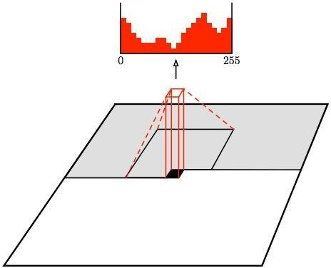
PixelCNN
PixelRNN
Still generate image pixels starting from corner
Dependency on previous pixels now modeled using a CNN over context region
Training: maximize likelihood of training images
Generation must still proceed sequentially
=> still slow

Slide 58
PixelCNN vs PixelRNN
PixelCNN vs PixelRNN
Pros:
Improving PixelCNN performance
Can explicitly compute likelihood p(x)
Explicit likelihood of training data gives good evaluation metric
Good samples
Gated convolutional layers
Short-cut connections
Discretized logistic loss
Multi-scale
Training tricks
Etc…
Con:
Sequential generation => slow
See
Van der Oord et al. NIPS 2016
Salimans et al. 2017 :PixelCNN++

Slide 59
Taxonomy of Generative Models
Taxonomy of Generative Models
Generative Model
Explicit Density
Implicit Density
Tractable Density
Approximate Density
Direct
Markov chain
Change of variables models Fully Visible Belief Nets
PixelRNN
Variational
Markov chain
GAN
GSN
PixelCNN
Variational Autoencoder
Boltzmann Machine
Figure copyright and adapted from Ian Goodfellow, Tutorial on Generative Adversarial Networks,
Deep Learning for Computer Vision
2017.
Generative Models
Slide #23

Slide 60
Autoencoders
Autoencoders

Slide 61
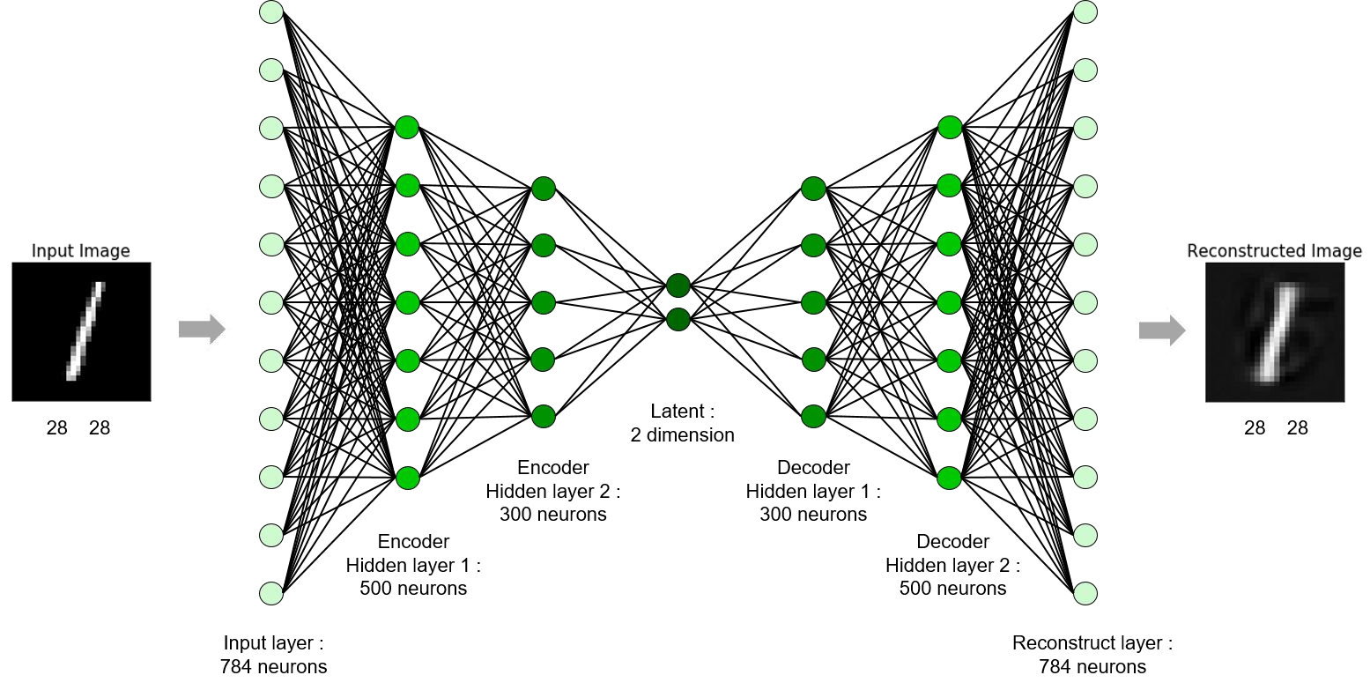
Autoencoders
Autoencoders
Encoder
Latent
Decoder

Slide 62

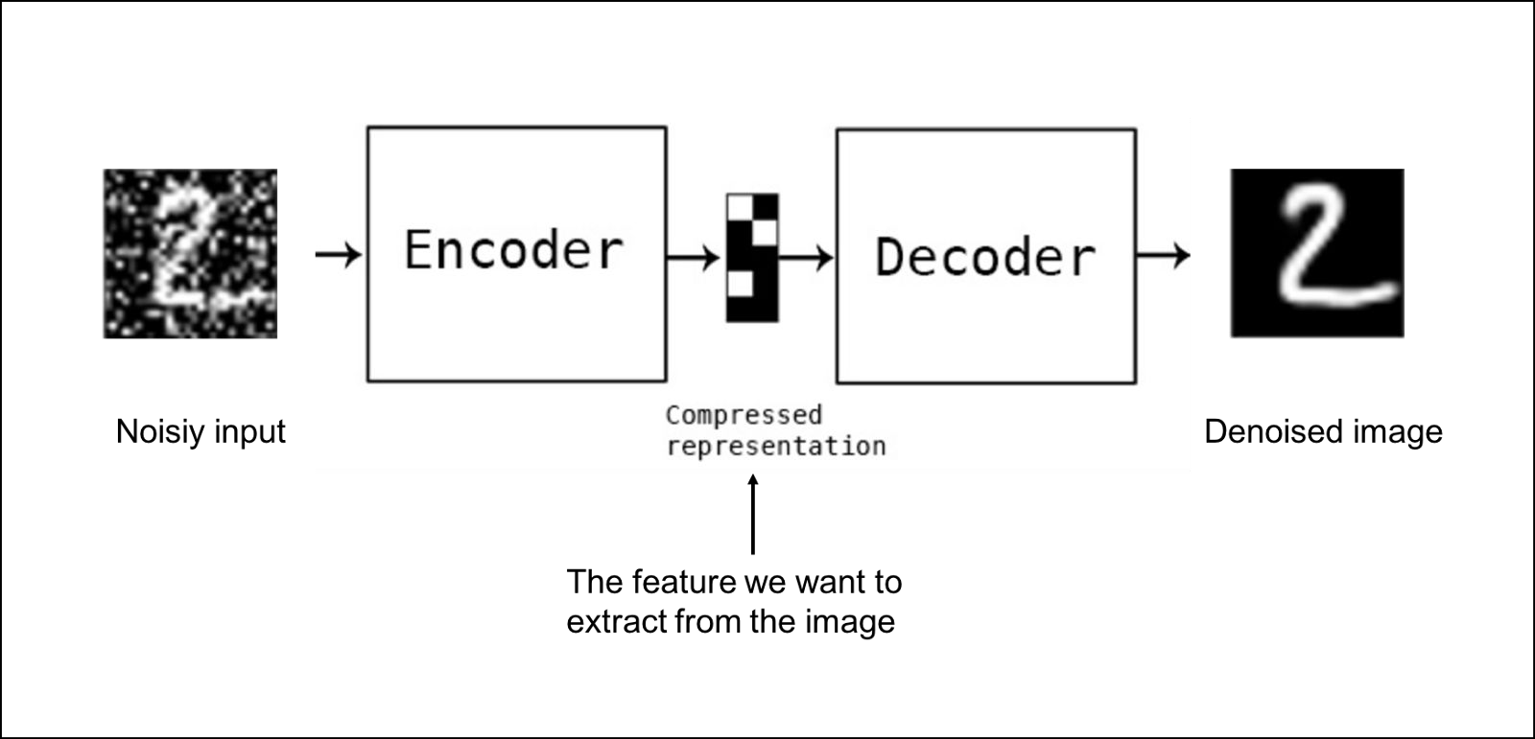
Denoised Autoencoder
Denoised Autoencoder

Slide 63
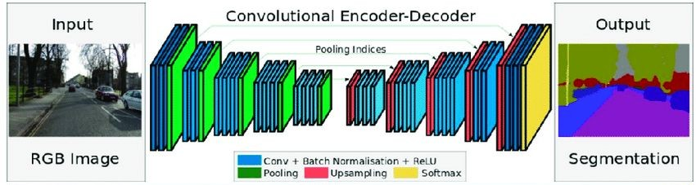


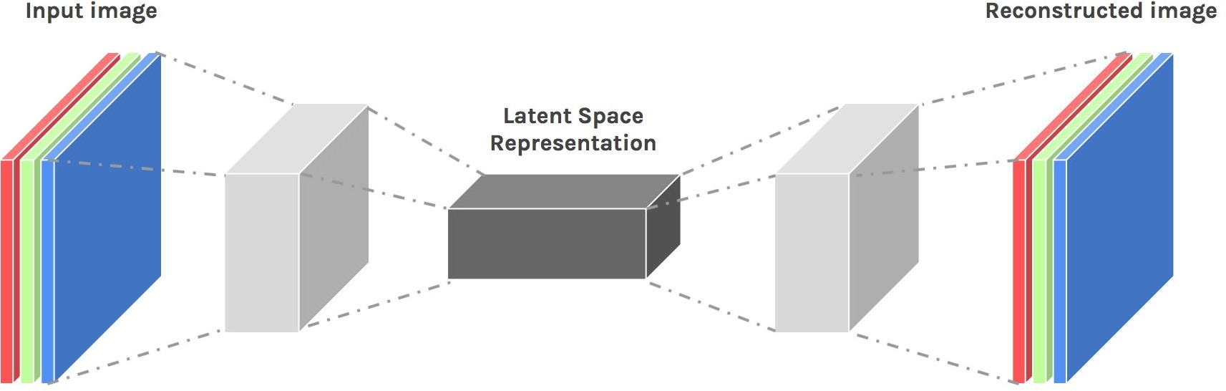
Autoencoder Application
Autoencoder Application
Semantic Segmentation
Neural Inpainting

Slide 64
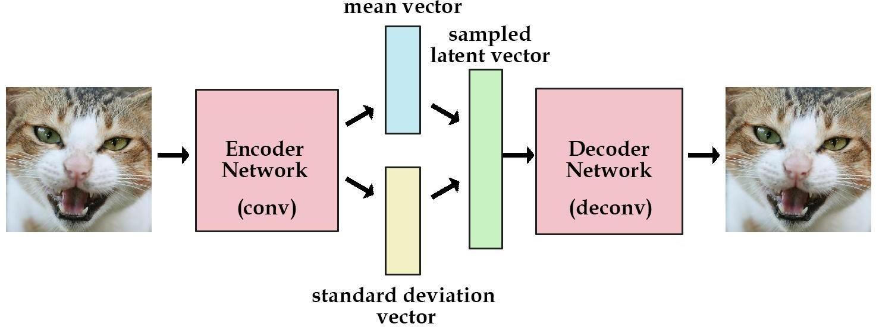
Variational Autoencoders (VAE)
Variational Autoencoders (VAE)
Reconstruction loss
Stay close to normal(0,1)

Slide 65
Variational Autoencoders (VAE)
Variational Autoencoders (VAE)
Z=µ+σΘε
Where ε ~ normal(0,1)

Slide 66
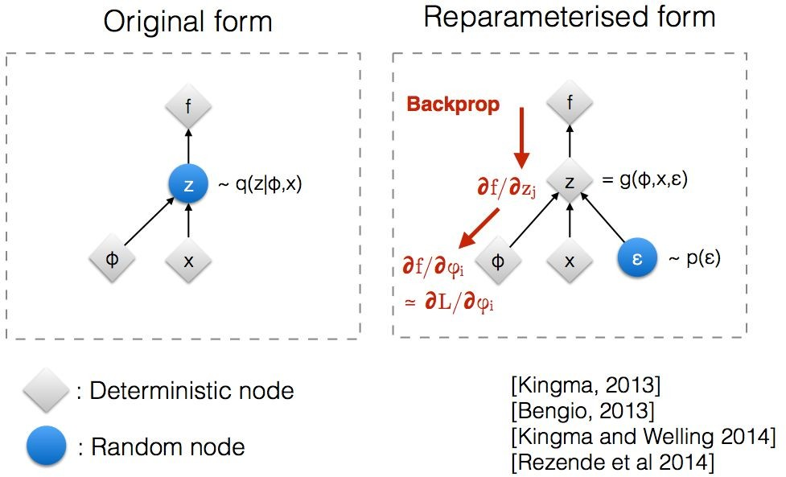
Variational Autoencoders (VAE)
Variational Autoencoders (VAE)
Model: Latent-variable model p(x|z, theta) usually specified by a neural network
Inference: Recognition network for q(z|x, theta) usually specified by a neural network
Training objective: Simple Monte Carlo for unbiased estimate of Variational lower bound
Optimization method: Stochastic gradient ascent, with automatic differentiation for gradients

Slide 67
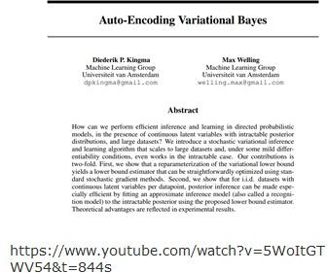
Variational Autoencoders (VAE)
Variational Autoencoders (VAE)
Pros
Flexible generative model
End-to-end gradient training
Measurable objective (and lower bound - model is at
least this good)
Fast test-time inference Cons:
sub-optimal variational factors
limited approximation to true posterior (will revisit)
Can have high-variance gradients

Slide 68
Taxonomy of Generative Models
Taxonomy of Generative Models
Generative Model
Explicit Density
Implicit Density
Tractable Density
Approximate Density
Direct
Markov chain
Change of variables models Fully Visible Belief Nets
PixelRNN
Variational
Markov chain
GAN
GSN
PixelCNN
Variational Autoencoder
Boltzmann Machine
Figure copyright and adapted from Ian Goodfellow, Tutorial on Generative Adversarial Networks,
Deep Learning for Computer Vision
2017.
Generative Models
Slide #32

Slide 69
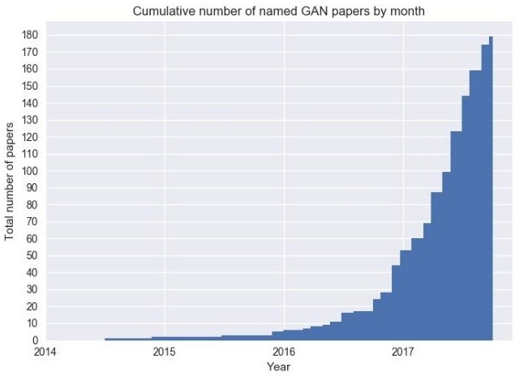
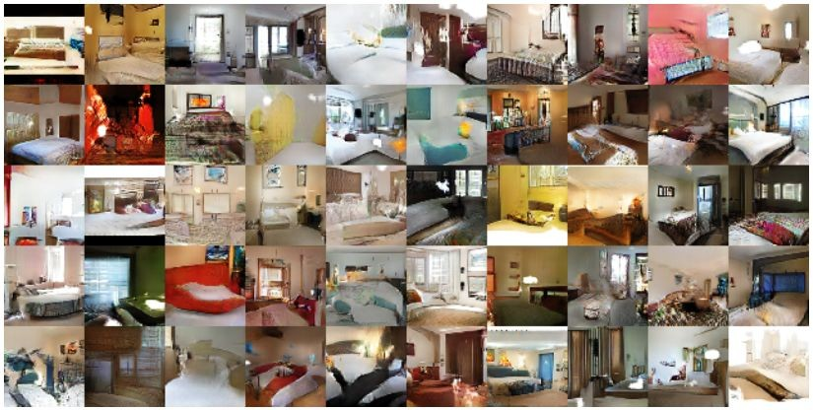
Generative Adversarial Networks ^{(Goodfellow et al., 2014)}
Generative Adversarial Networks
GANs or GAN for short
Active research topic
Have shown great improvements in image generation
https://github.com/hindupuravinash/the-gan-zoo
Radford et al., 2016

Slide 70
Generative Adversarial Networks ^{(Goodfellow et al., 2014)}
Generative Adversarial Networks
Generator (G) that learns the real data distribution to generate fake samples
Discriminator (D) that attributes a probability p of confidence of a sample being real (i.e. coming from the training data)
Training data
Real sample
Discriminator
D
Is sample real?
p
Generator
G
Fake sample
Noise

Slide 71
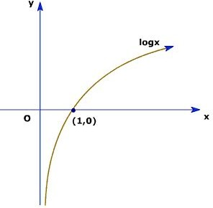
Generative Adversarial Networks ^{(Goodfellow et al., 2014)}
Generative Adversarial Networks
Both models are trained together (minimax game):
G: Increase the probability of D making mistakes
D: Classify real samples with greater confidence
G slightly changes the generated data based on D’s feedback
▪
Ideal scenario (equilibrium): G will eventually produce such realistic samples that D attributes p = 0.5 (i.e. cannot distinguish real and fake samples)

Slide 72
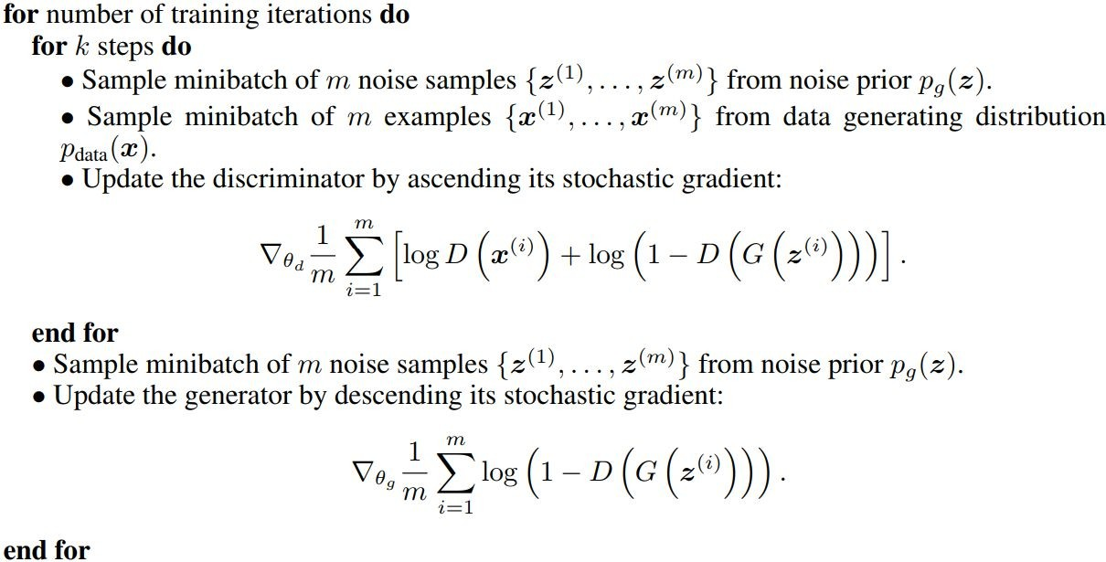
Generative Adversarial Networks ^{(Goodfellow et al., 2014)}
Generative Adversarial Networks

Slide 73
Conditional GANs (CGAN) ^{(Mirza et al., 2014)}
Generative Adversarial Networks
G and D can be conditioned by additional information y
Adding y as an input of both networks will condition their outputs
y can be external information or data from the training set
Training data
Real sample
Discriminator
D
Is sample real, given
y?
y
p
Noise
Generator
G
Fake sample
y

Slide 74
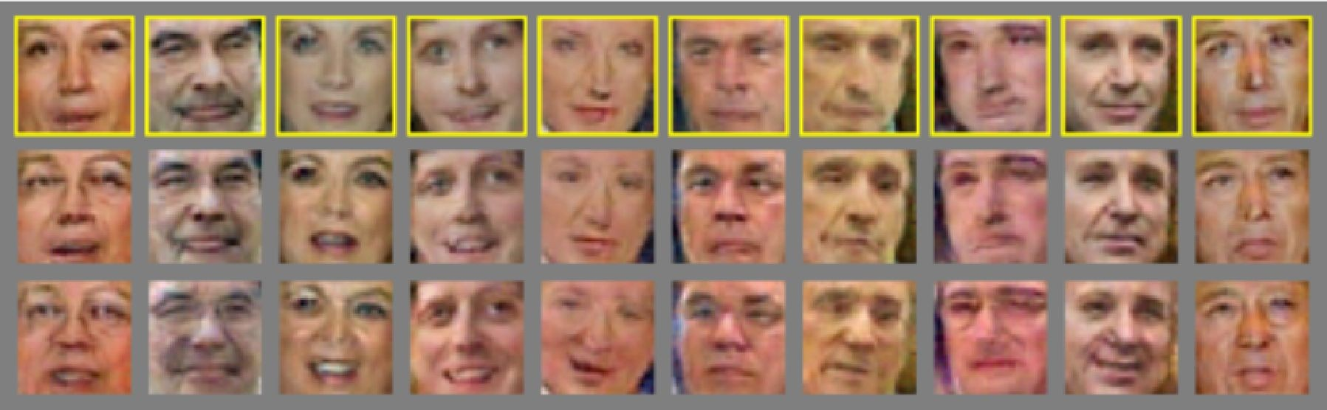
Conditional GANs (CGAN) ^{(Mirza et al., 2014)}
Conditional GANs (CGAN)
y = Senior
y = Mouth open
Gauthier, 2015

Slide 75
Conditional GANs (CGAN) ^{(Mirza et al., 2014)}
Generative Adversarial Networks
y = Senior
y = Mouth open
Gauthier, 2015

Slide 76
Conditional GANs (CGAN) ^{(Mirza et al., 2014)}
Generative Adversarial Networks
y = Senior
y = Mouth open
Gauthier, 2015

Slide 77
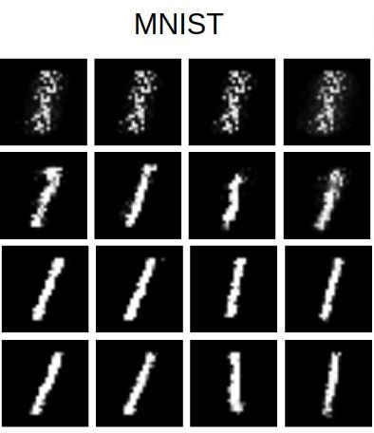
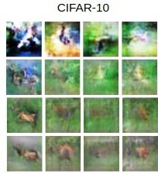
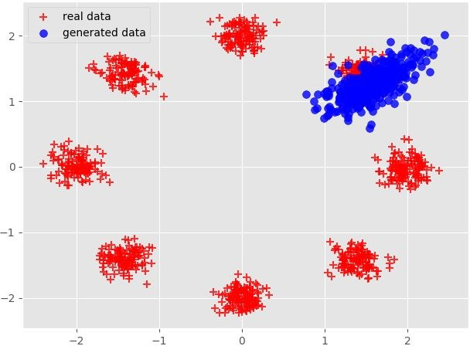
Limitations of GANs
Limitations of GANs
Training instability
Good sample generation requires reaching Nash Equilibrium in the game, which might not always happen
Mode collapse
When G is able to fool D by generating similarly looking samples from the same data mode
GANs were original made to work only with real-valued, continuous data (e.g. images)
Slight changes in discrete data (e.g. text) are impractical
Chart 41
Chart 41
Deep Learning for Computer Vision
Generative Models

Slide 78
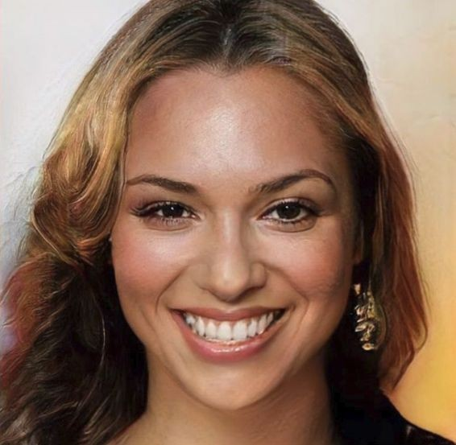
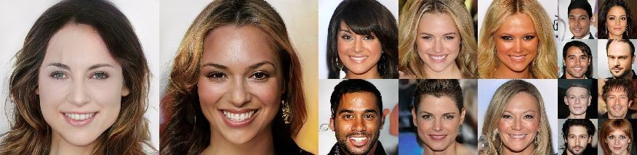
Evaluation metrics
Evaluation metrics
What makes a good generative model?
Each generated sample is indistinguishable from a real sample
Generated samples should have variety
Deep Learning for Computer Vision
Generative Models
Images from Karras et al., 2017
Slide #44

Slide 79
Evaluation metrics
Limitations of GANs
How to evaluate the generated samples?
Cannot rely on the models’ loss :-(
Human evaluation :-/
Use a pre-trained model :-)

Slide 80
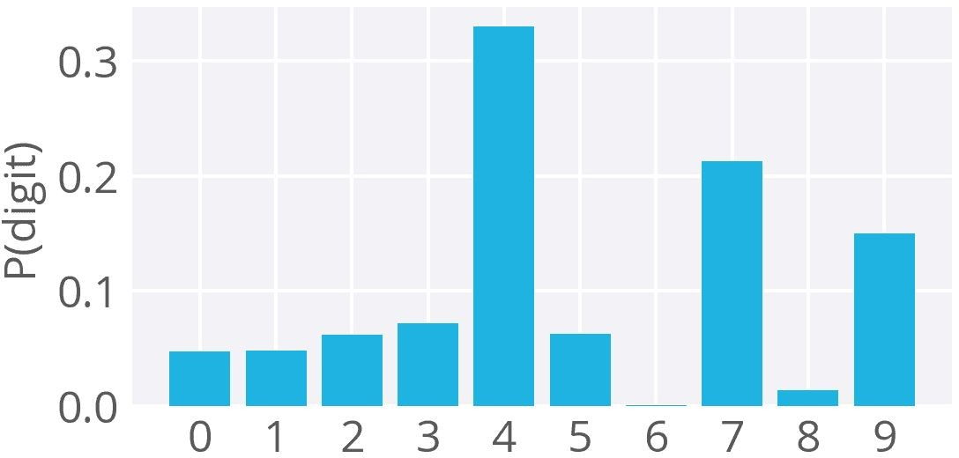



Evaluation metrics
Limitations of GANs
Inception Score (IS) [Salimans et al., 2016]
Inception model (Szegedy et al., 2015) trained on ImageNet
Given generated image x, assigned the label y by model p:
low entropy (one class)
https://github.com/Kulbear/dee p-learning-nano-foundation/wiki
/ReLU-and-Softmax-Activation-F unctions
The distribution over all generated images should be spread (evaluating mode collapse)
high entropy (many classes)
Combining the above, we get the final metric:

Slide 81

Evaluation metrics
Evaluation metrics
Fréchet Inception Distance (FID) [Heusel et al., 2017]
Calculates the distance between real and fake data (lower the better)
Uses the embeddings of the real and fake data from the last pooling layer of Inception v3.
Converts the embeddings into continuous distributions and uses the mean and
covariance of each to calculate their distance.

Slide 82
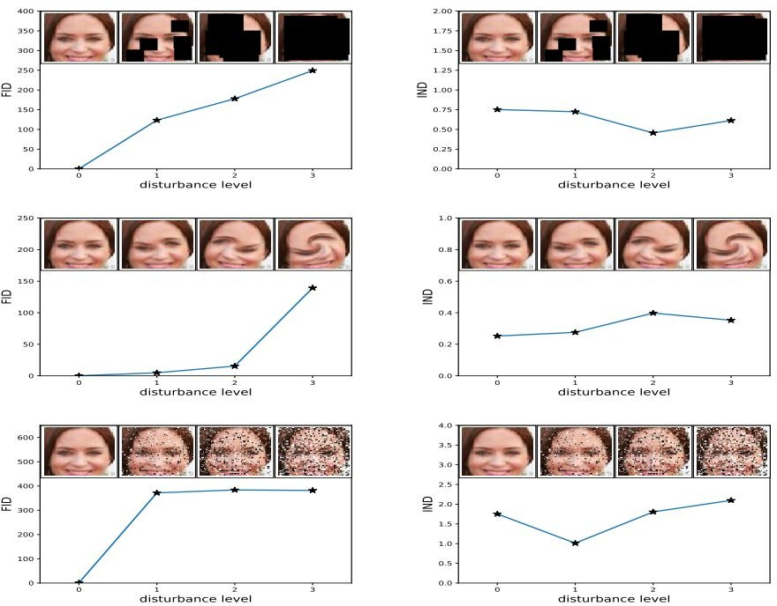
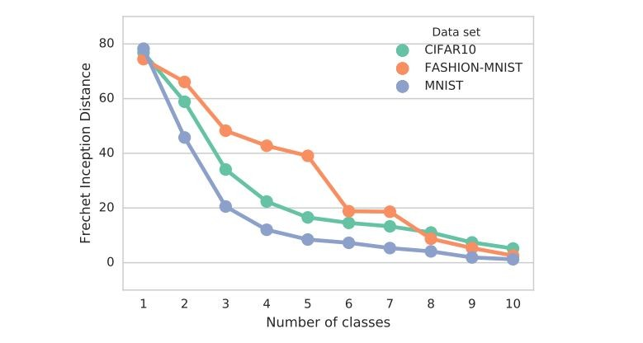
Evaluation metrics
Evaluation metrics
IS vs FID
FID considers the real dataset
FID requires less sampling (faster) (~10k instead of 50k in IS)
FID more robust to noise and human judgement
FID also sensitive to mode collapse
FID (lower is better) IS (higher is better)
Images from Lucic et al., 2017 and Heusel et al., 2017
Deep Learni
ng for Computer Vision
Generative Models

Slide 83
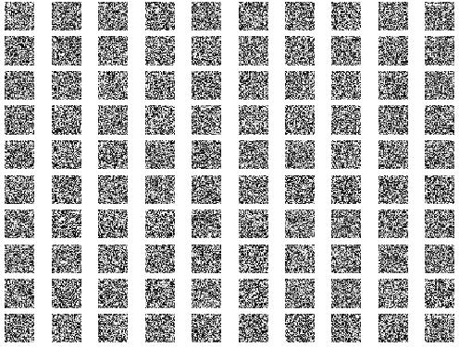
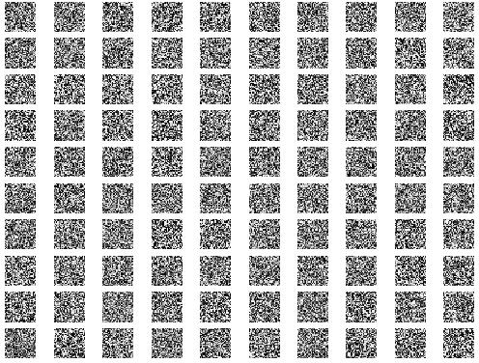
Practical scenario
Practical scenario
MNIST (handwritten dataset)
Condition the number generation per row
GAN
CGAN
https://github.com/gftm/Class_Generative_Networks

Slide 84
Practical scenario
Practical scenario
Task 1 - Add label as input to both models (plus the combined model)
Task 2 - Get labels (y) from dataset
Task 3 - Add labels to the models’ losses
Task 4 - Generate specific numbers for each row
https://github.com/gftm/Class_Generative_Networks

Slide 85
Practical scenario
Practical scenario
Task 1 - Add label as input to both models (plus the combined model)
def init (self):

Slide 86
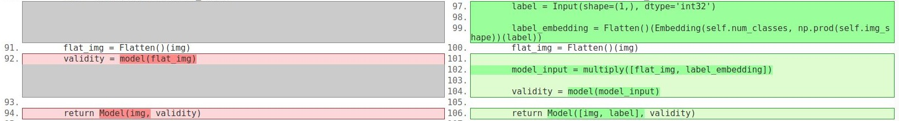
Practical scenario
Practical scenario
Task 1 - Add label as input to both models (plus the combined model)
def build_generator(self):
def build_discriminator(self):

Slide 87
Practical scenario
Practical scenario
Task 2 - Get labels (y) from dataset
def train(self, epochs, batch_size=128, sample_interval=50):

Slide 88
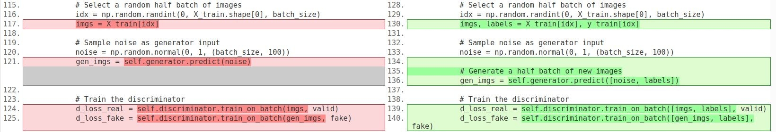
Practical scenario
Practical scenario
Task 3 - Add labels to the models’ losses
def train(self, epochs, batch_size=128, sample_interval=50):

Slide 89
Practical scenario
Practical scenario
Task 4 - Generate specific numbers for each row
def sample_images(self, epoch):

Slide 90
Practical scenario
ZFNet
Main characteristics of ZFNet
As ZFNet (Zeiler Furgus Net) seems to be an enhanced modification of AlexNet through investigation of internal operations and behaviours of the model, many characters were addressed in comparison with AlexNet.
Visualisation techniques used as a diagnostic role
Ablation study to identify performance contribution from different model layers (e.g. cnn vs fc layer - which contributes more)
Sensitivity analysis through occluding portions of an image
Improved hyperparameters as a result of further investigations above
Reduced Top 5 error rate to 14.8% with 6 convnets compared to AlexNet (best result 15.3% with 7 convnets) on ILSVRC-2012
Transfer learning to datasets other than ImageNet displaying generalisation ability of the model

Slide 91
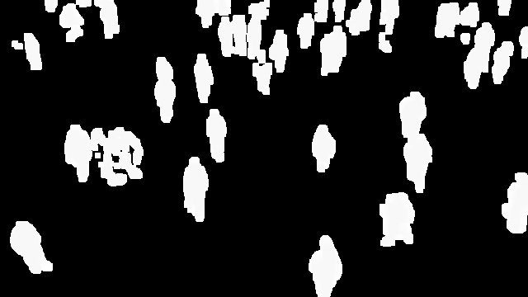
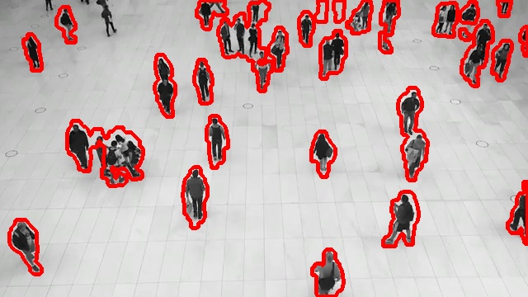
Observation of Moving Objects
Moving Object Detection and Segmentation
Step 1: Read 8 Consecutive Frames from the Video
Step 2: Convert the Frames into Grayscale
Step 3: Frame Differencing
Step 4: Add the 8 Frames
Step 5: Fill the Gaps Inside the Objects
Step 6: Convert to Binary
Step 7: Remove Noise from the Resulting Image

Slide 92

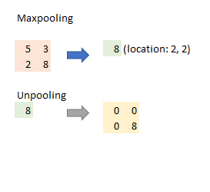
Unpooling
Maxpooling is not invertible, but it can be approximated by recording the locations of maxima, preserving structure of the stimulus.

Slide 93
Rectification
Unpooled feature reconstructions (that are always positive) go through ReLU.
3. Filtering
Conv layer uses defined filters to convolve output from the previous input. This could be simplified as:
Input @ Filter = Output
where @ is matrix multiplication.
Therefore, deconvnet used the transposed versions of the same filters on the output from Rectification above (2. Rectification), which was simplified as:
Reconstructed Input = Output @ Transposed Filter
With these three components of deconvnet, the authors were able to visualise all layers in AlexNet.

Slide 94
AlexNet
main changes to AlexNet?
First layer filters were changed their size from 11 * 11 to 7 * 7 and its stride became 2 instead of 4.
Dense connections were used on layer 3, 4, and 5 from AlexNet because ZFNet was trained on a single GTX580 GPU.
After visualising the first layer filters, the authors realised that a few of the layer filters dominated so they renormlise each filter in the conv layers where the root mean square value exceeds a fixed radius of 1/10 to the current fixed radius.

Slide 95
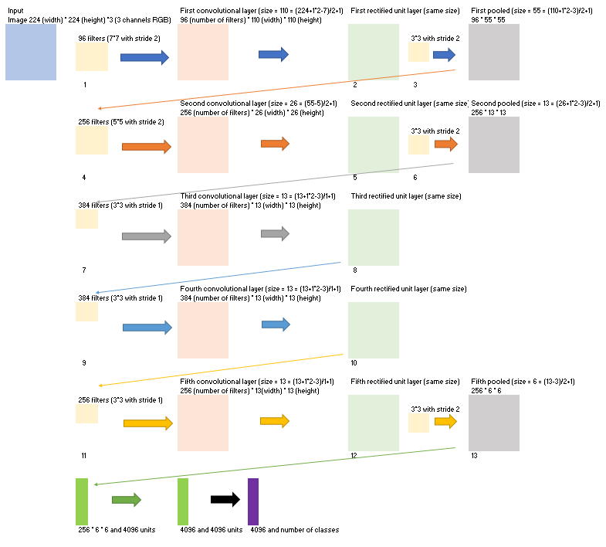

Slide 96


Retrieval of Images Based on Their Contents
The retrieval of images based on their content is known as content-based image retrieval (CBIR). CBIR aims to find images that are visually similar or relevant to a given query image, without relying on textual metadata or annotations. It relies on the visual features extracted from the images themselves to perform the search.

Slide 97
Retrieval of Images Based on Their Contents
Feature Extraction: The first step is to extract meaningful features from the images. Various low-level and high-level visual features can be used, such as color histograms, texture descriptors, shape descriptors, deep learning features (e.g., features from convolutional neural networks), or a combination of these. The choice of features depends on the specific requirements and characteristics of the image dataset.
Feature Representation: The extracted features are then typically transformed into a suitable representation for efficient indexing and retrieval. This can involve techniques like vector quantization, dimensionality reduction (e.g., using techniques like Principal Component Analysis or t-SNE), or feature aggregation.
Indexing: The transformed feature representations are organized in a way that enables fast search and retrieval. Indexing structures like inverted files, k-d trees, or hash-based methods are commonly used to efficiently index the feature data.
Similarity Measurement: When a query image is provided, its features are extracted and compared to the features in the indexed database. Various similarity or distance measures, such as Euclidean distance, cosine similarity, or the Jaccard index, can be used to quantify the similarity between the query features and the features of the indexed images.
Ranking and Retrieval: Based on the similarity measurements, the indexed images are ranked in descending order of relevance to the query. The most similar images are returned as the retrieval results.

Slide 98

Retrieval of Images Based on Their Contents
Recently, state-of-the-art CBIR systems have started using machine-learning methods such as deep-learning algorithms. They can perform feature extraction far better than traditional methods.
Usually, a Deep Convolutional Neural Network (DCNN) is trained using available data. Its job is to extract features from images. So, when a user sends the query image to the database system, DCNN extracts its features. Then, the query-image features are compared to those of the database images. In that step, the database system finds the most similar images using similarity measures and returns them to the user:

Slide 99
Most popular example Categorization of IMAGES
Computer Vision Tasks classification, Instance segmentation. Convolutional Neural Networks, Evolution of CNN Architectures for Image, Recent CNN

Slide 100
Faculty Video Links, Youtube & NPTEL Video Links and Online Courses Details
Youtube/other Video Links
https://nptel.ac.in/courses/106106093/
https://www.youtube.com/watch?v=m-aKj5ovDfg
https://www.youtube.com/watch?v=G4NYQox4n2g

Slide 101
DAILY QUIZ
What is computer vision?
Name three common applications of computer vision.
What is the purpose of image segmentation in computer vision?
What is the difference between object detection and object recognition?
Explain the concept of convolution in convolutional neural networks (CNNs).

Slide 102
DAILY QUIZ
What is optical character recognition (OCR) used for in computer vision?
What is the purpose of non-maximum suppression in object detection algorithms?
What are some common challenges faced in computer vision tasks?
What is the difference between supervised and unsupervised learning in computer vision?
Name three popular deep learning architectures used in computer vision.

Slide 103
WEEKLY ASSIGNMENT
Explain the concept of image filtering and provide examples of commonly used filters in computer vision.
Discuss the differences between image classification and object detection in computer vision. Provide examples of each.
Explain the process of feature extraction in computer vision. How are features used in tasks like object recognition or image matching?
Describe the steps involved in building a convolutional neural network (CNN) for image classification. Discuss the purpose of each step.

Slide 104
WEEKLY ASSIGNMENT
Discuss the challenges and potential solutions for handling occlusion in object detection algorithms.
Compare and contrast traditional computer vision techniques with deep learning-based approaches. What are the advantages and limitations of each?
Explain the concept of image segmentation and its applications in computer vision. Discuss different segmentation methods.
Discuss the concept of optical flow in computer vision. How is it used to analyze motion in videos or sequences of images?
Explain the concept of image registration and its applications in computer vision. Provide examples of scenarios where image registration is useful.
Discuss the role of data augmentation techniques in computer vision tasks. How can data augmentation improve the performance of deep learning models?

Slide 105
WEEKLY ASSIGNMENT
Explain the concept of object tracking in computer vision. Discuss different algorithms or techniques used for object tracking.
Describe the process of image recognition using convolutional neural networks (CNNs). What are the key components and steps involved?
Discuss the concept of depth estimation in computer vision. Explain how depth information can be extracted from 2D images.
Explain the concept of image stitching and its applications. How are multiple images combined to create a panoramic image?
Discuss the challenges and approaches for handling scale invariance in object detection algorithms.
Describe the concept of facial recognition in computer vision. Discuss its applications, advantages, and potential privacy concerns.
Explain the concept of semantic segmentation and its applications in computer vision. Provide examples of scenarios where semantic segmentation is useful.
Discuss the concept of object recognition using feature descriptors. Explain popular feature descriptor algorithms such as SIFT or SURF.
Explain the concept of image super-resolution and its applications. How can low-resolution images be enhanced to improve their quality?
Discuss the role of transfer learning in computer vision. How can pre-trained models be utilized for new tasks or datasets?

Slide 106
MCQ s
Question 1: What is computer vision?
A. The study of computers and their components
B. The field of processing and understanding visual data by computers
C. The development of computer software for image editing
D. The study of visual perception in humans
Question 2: Which of the following is an application of computer vision?
A. Speech recognition
B. Natural language processing
C. Object detection
D. Network security
Question 3: Which technique is commonly used for feature extraction in computer vision?
A. Convolutional Neural Networks (CNN)
B. Decision Trees
C. Support Vector Machines (SVM)
D. K-means clustering

Slide 107
MCQ s
Question 4: What is the purpose of image segmentation in computer vision?
A. Classifying images into different categories
B. Detecting and recognizing objects in images
C. Enhancing and manipulating image quality
D. Dividing an image into meaningful regions or segments
Question 5: Which of the following is an example of an object recognition task in computer vision?
A. Determining the sentiment of an image
B. Identifying the boundaries of objects in an image
C. Recognizing specific objects in an image, such as cars or faces
D. Analyzing the texture or color distribution of an image
Question 6: Which technique is commonly used for image classification in computer vision?
A. Principal Component Analysis (PCA)
B. Naive Bayes classifier
C. Latent Semantic Analysis (LSA)
D. Convolutional Neural Networks (CNN)

Slide 108
MCQ s(CONT’d)
What is computer vision? Answer: c. Computer vision is a field of artificial intelligence that focuses on enabling computers to interpret and understand visual information from images or videos.
Name three common applications of computer vision. Answer: a. Autonomous vehicles, b. Object recognition, c. Medical image analysis
What is the purpose of image segmentation in computer vision? Answer: b. Image segmentation aims to partition an image into meaningful regions or segments to facilitate object detection, tracking, or analysis.
What is the difference between object detection and object recognition? Answer: c. Object detection involves both localizing and classifying objects within an image, while object recognition focuses solely on identifying objects without localizing them.
Explain the concept of convolution in convolutional neural networks (CNNs). Answer: a. Convolution involves applying a filter/kernel to an input image or feature map, computing element-wise multiplications, and summing the results to produce a feature map.

Slide 109
MCQ s(CONT’d)
What is optical character recognition (OCR) used for in computer vision? Answer: b. OCR is used to convert printed or handwritten text from images into machine-readable text, enabling automated text analysis or data extraction.
What is the purpose of non-maximum suppression in object detection algorithms? Answer: a. Non-maximum suppression is used to eliminate redundant bounding box detections by keeping only the most confident detection and suppressing overlapping or lower-confidence detections.
What are some common challenges faced in computer vision tasks? Answer: c. Variations in lighting conditions, occlusion, viewpoint changes, and limited labeled data are common challenges in computer vision tasks.
What is the difference between supervised and unsupervised learning in computer vision? Answer: b. Supervised learning requires labeled training data, where input images are associated with corresponding ground-truth labels. Unsupervised learning involves learning patterns or structures from unlabeled data without explicit labels.

Slide 110
EXPECTED QUESTIONS FOR UNIVERSITY EXAM
Explain the GAN Architecture’s Operation & Its Difference From Other Models.
Provide an Example of a Real-world Issue that GAN Was Used to Resolve.
List Some Difficulties in Training GAN and How to Get Around Them.
How Does GAN Handle Complex, Multi-modal Distribution?
Compared to Other Generative Models like Variational Autoencoders (VAE),How do GAN Architectures Fare?
Discuss Any Recent Developments or Breakthroughs in GANs?
How a GAN’s Generator and Discriminator Cooperate to Enhance the Model’s Performance?
How Can GAN Architecture be Used for Unsupervised Learning?
How Does GAN Architecture Handle High-dimensional Data?
Can you Talk About Ethical Issues When Using GANs, Particularly When Creating Realistic Synthetic Data?

Slide 111
EXPECTED QUESTIONS FOR UNIVERSITY EXAM
How does GAN Training Scale with Batch Size?
What is the Relationship Between GANs and Adversarial Examples?
How Can we Scale GANs Beyond Image Synthesis?
What Sorts of Distributions Can GANs Model?
What are the Trade-Offs Between GANs and other Generative Models?
Can you explain the difference between deep learning and traditional machine learning?
Why are generative adversarial networks (GANs) so popular?
Why are generative adversarial networks (GANs) so popular?
Explain the difference between the discriminative and generative models
Why GANs are called implicit density models?
Which GAN implementation is among the most well-liked and effective
Described as a deep learning technique that employs some conditional parameters.

Slide 112
SUMMARY
Computer vision is a field of study that deals with the extraction of information from images or videos to understand and interpret visual data. It involves the development of algorithms and techniques to enable computers to perceive and understand the visual world in a way similar to humans.
Computer vision encompasses various tasks and applications, including image classification, object detection, image segmentation, facial recognition, scene understanding, and video analysis. These tasks involve processing and analyzing visual data to extract meaningful information and make decisions based on it.
The fundamental concepts in computer vision include image formation, image processing, feature extraction, and pattern recognition. Image formation deals with how images are captured and represented using pixels. Image processing techniques are used to enhance and manipulate images to improve their quality or extract specific information. Feature extraction involves identifying relevant visual characteristics or patterns from images that can be used for tasks like object recognition or tracking.

Slide 113
SUMMARY
Computer vision techniques employ both traditional computer vision algorithms and deep learning approaches. Traditional algorithms rely on handcrafted features and mathematical models to process and analyze visual data. Deep learning methods, particularly convolutional neural networks (CNNs), have gained popularity in recent years due to their ability to learn directly from raw pixel data and achieve state-of-the-art results in various computer vision tasks.
Computer vision finds applications in diverse fields such as autonomous vehicles, surveillance systems, medical imaging, robotics, augmented reality, and industrial automation. It plays a crucial role in enabling machines to understand and interact with the visual world, opening up possibilities for advanced applications and advancements in numerous domains.
As computer vision continues to evolve, researchers and practitioners explore new techniques, algorithms, and applications to tackle more complex challenges and improve the accuracy and efficiency of visual understanding by machines.

Slide 114
REFERENCES
"Computer Vision: Algorithms and Applications" by Richard Szeliski
This comprehensive book covers the fundamental concepts and algorithms in computer vision, including image formation, image features, stereo vision, multiple view geometry, and object recognition. It also includes numerous examples and MATLAB code snippets.
"Deep Learning for Computer Vision with Python" by Adrian Rosebrock
This book focuses on applying deep learning techniques to solve computer vision problems. It covers topics such as convolutional neural networks (CNNs), image classification, object detection, and image segmentation. The book provides practical examples and code implementations using Python and the Keras library.
"Computer Vision: Models, Learning, and Inference" by Simon J.D. Prince
This book provides a comprehensive introduction to computer vision, covering various topics such as image formation, filtering, feature detection and matching, object recognition, and 3D reconstruction. It also includes discussions on statistical and probabilistic models in computer vision.
https://www.oreilly.com/library/view/datawarehousingarchitecture/0130809020/ch07.html
https://www.slideshare.net/2cdude/data-warehousing-3292359

Slide 115
Any Certification/Courses for this subject
Course Name | Offered By | Duration | Rating | Link
Introduction to Computer Vision and Image Processing | IBM | 1-4 weeks | 4.4 | https://www.coursera.org/learn/introduction-computer-vision-watson-opencv#about
Computer Vision Basics | University at Buffalo | 1-4 weeks | 4.2 | https://www.coursera.org/learn/computer-vision-basics#syllabus

Slide 116
OPTIONAL / CASE STUDIES
OPTIONAL / CASE STUDIES
Factors influencing the adoption of new mobility technologies and services:,
1 Drone Systems and Applications ( Healthcare, Agriculture, Security)
2 Autonomous Vehicular System
3 Motion Prediction for Autonomous Vehicles
4 Clinical applications Robotic surgery

Slide 117
Thank You

